Slide 1
Presentation Title
Group 3
Yange Sun, Lechen Zha, Crist Lian, Junmou Tang, Shiyue Yang

Slide 2
Idea‑1 — Users & Value
Example Subtitle
The standard text area has five predefined type levels.
You can move up or down the levels using the increase or decrease indent buttons in the home tab.
We recommend that you do not use the bullet button, as this does not apply the correct bullet formatting.
Level one is for general text
Level two is for subheadings within body copy
Level three is the first level of bullets
Level four is the second level of bullets
Level five is the third level of bullets
While text boxes are formatted to be the correct font, size, and colour, they will not contain the levels as a placeholder does. Therefore, it is recommended that you copy an existing text placeholder on the slide if you would like to insert a text box, to preserve the use of these levels.

Slide 3
Idea‑2 — Users & Value
The standard text area has five predefined type levels.
You can move up or down the levels using the increase or decrease indent buttons in the home tab.
We recommend that you do not use the bullet button, as this does not apply the correct bullet formatting.
While text boxes are formatted to be the correct font, size, and colour, they will not contain the levels as a placeholder does. Therefore, it is recommended that you copy an existing text placeholder on the slide if you would like to insert a text box, to preserve the use of these levels.

Slide 4
Idea‑2 — Problem · Gap · Approach
Example Subtitle
The standard text area has five predefined type levels.
You can move up or down the levels using the increase or decrease indent buttons in the home tab.
We recommend that you do not use the bullet button, as this does not apply the correct bullet formatting.
Level one is for general text
Level two is for subheadings within body copy
Level three is the first level of bullets
Level four is the second level of bullets
Level five is the third level of bullets
While text boxes are formatted to be the correct font, size, and colour, they will not contain the levels as a placeholder does. Therefore, it is recommended that you copy an existing text placeholder on the slide if you would like to insert a text box, to preserve the use of these levels.

Slide 5
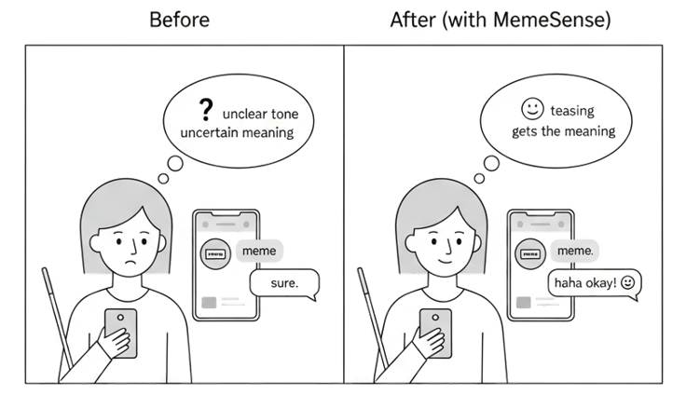
Idea‑3 — Users & Value
MemeSense: A Social-Intuition Augmentation Interface for BLV users
Target users: Blind and Low-Vision (BLV) users in mobile messaging
Core idea: enable BLV users to access the meaning/intent behind memes and emoji-rich messages
What changes: from “literal content only” → to “social meaning understood” in real-time chat
Value: reduces hesitation and mis-replies when tone is ambiguous (e.g., teasing vs annoyed)

Slide 6
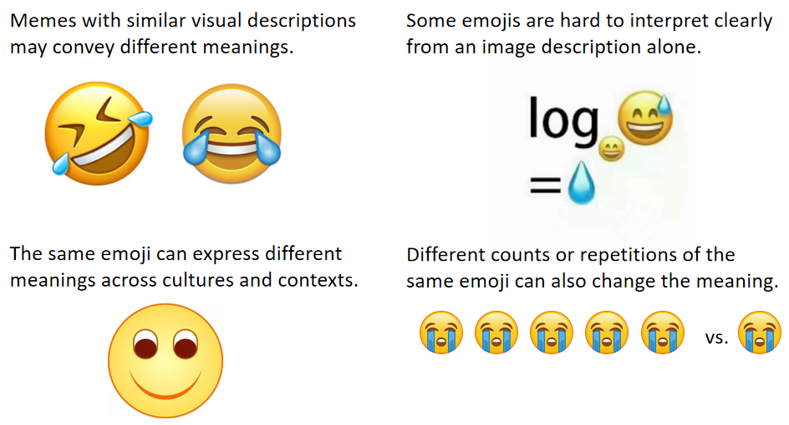
Idea‑3 — Problem · Gap · Approach
The gap of current technology
Messaging today is visual and context-heavy: memes, emojis, reaction images carry tone and intent
Current tools are mostly literal: screen readers read text; images often become “image”/basic description
Why memes are hard: same image/emoji can imply different intent across context/culture; repetition changes meaning

Slide 7
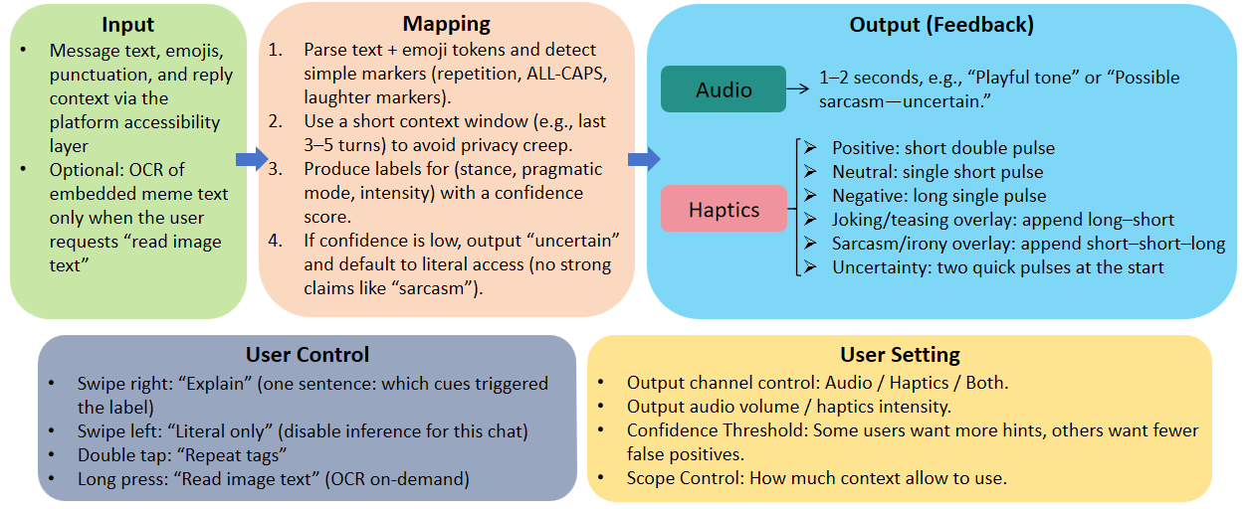
Idea-3
Interface Design

Slide 8
Section Title
Section Subtitle

Slide 9
Thank you

